Slide 1
SECURE PASSWORD STORAGE WITH KEY DERIVATION FUNCTIONS
NAME : AKASH S
REG NO : 21BCE1705
COURSE CODE : BCSE309L
COURSE TITLE : CRYPTOGRAPHY AND NETWORK SECURITY

Slide 2
INTRODUCTION:
In today's digital age, ensuring the security of sensitive information is paramount. KDFs serve as indispensable tools in the realm of cryptography, enabling the generation of secure cryptographic keys from low-entropy input data. In an era where cyber threats are rampant, KDFs play a critical role in fortifying cryptographic systems against brute-force and dictionary attacks. By deriving keys with high entropy from low-entropy input, such as passwords, KDFs ensure that attackers face significant hurdles in compromising data security.
What are Key Derivation Functions (KDFs)?
Key Derivation Functions (KDFs) are cryptographic algorithms designed to derive secret keys from input data, such as passwords, passphrases, or other low-entropy secrets. They play a critical role in various cryptographic applications, including secure communication, authentication protocols, key management, and password hashing. When using KDFs, it's crucial to consider factors such as the choice of hash function, parameter selection, and resistance to various attacks.
There are several techniques and algorithms used for password hashing and key derivation, each with its own characteristics and security considerations. The algorithms mainly focused in this project include: PBKDF2, bcrypt, scrypt, Argon2.

Slide 3
PROBLEM STATEMENT
In this digital world, we know passwords are hashed and stored in servers or databases. However, traditional password storage mechanisms, such as plaintext or simple hashing, are no longer sufficient to withstand sophisticated attacks.
Secure password storage requires the use of robust cryptographic techniques, such as Key Derivation Functions (KDFs), to convert user passwords into secure cryptographic keys. KDFs play a crucial role in enhancing password security by iteratively applying cryptographic operations to passwords, effectively increasing their entropy and resistance to brute-force and dictionary attacks. This problem statement seeks to explore and implement secure password storage solutions using KDFs, ensuring the confidentiality and integrity of user credentials in various applications and systems.
NIST Special Publication 800-132. (2010). "Recommendation for Password-Based Key Derivation.“
Percival, C. (2009). "Stronger Key Derivation via Sequential Memory-Hard Functions."

Slide 4
OBJECTIVES
To implement a secure password storage mechanism that utilizes Key Derivation Functions (KDFs) to convert user passwords into cryptographic keys. This aims to enhance the security of stored passwords by making them resistant to common attacks such as brute-force and dictionary attacks.
To ensure the confidentiality and integrity of user credentials by securely storing hashed passwords generated using KDFs.
To develop a robust salting strategy to generate and apply unique salt values to each password before hashing. This prevents identical passwords from producing the same hash values, adding an extra layer of security against precomputed dictionary attacks.
Another objective is to seamlessly integrate the secure password storage mechanism with existing authentication systems or user management frameworks. This ensures compatibility with industry-standard protocols and frameworks, facilitating easy adoption and integration into existing infrastructure.

Slide 5
ABSTRACT
In today's digital landscape, secure password storage is paramount to safeguarding sensitive user information against unauthorized access and data breaches. Traditional approaches to password storage, such as plaintext storage or weak cryptographic hashing, are insufficient to protect passwords from increasingly sophisticated attacks.
To address this challenge, the use of Key Derivation Functions (KDFs) has emerged as a fundamental technique to securely hash and store passwords. This paper explores the problem statement of secure password storage with Key Derivation Functions, emphasizing the importance of adopting robust cryptographic techniques to mitigate common threats like brute-force attacks, dictionary attacks, and rainbow table attacks.
By addressing the problem statement of secure password storage with Key Derivation Functions, organizations can enhance their cybersecurity posture, protect user credentials, and maintain the confidentiality and integrity of sensitive data.

Slide 6
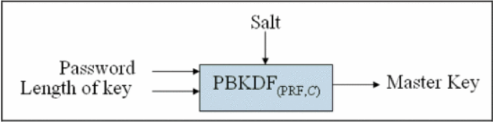
PBKDF2
PBKDF2, which stands for Password-Based Key Derivation Function 2, is a widely-used cryptographic algorithm designed to securely derive cryptographic keys from passwords. The main purpose of PBKDF2 is to convert low-entropy passwords into high-entropy cryptographic keys suitable for encryption, decryption, or authentication. It achieves this by applying a pseudorandom function iteratively to the input password along with a salt value. The number of iterations determines the computational cost of the algorithm, making it resistant to brute-force attacks.

Slide 7
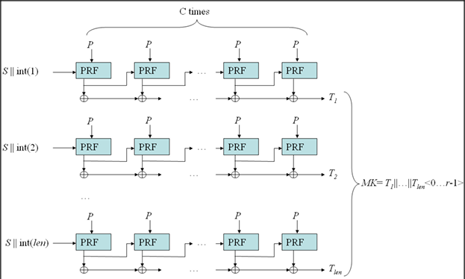
A GENERAL DIAGRAM FOR PBKDF2

Slide 8
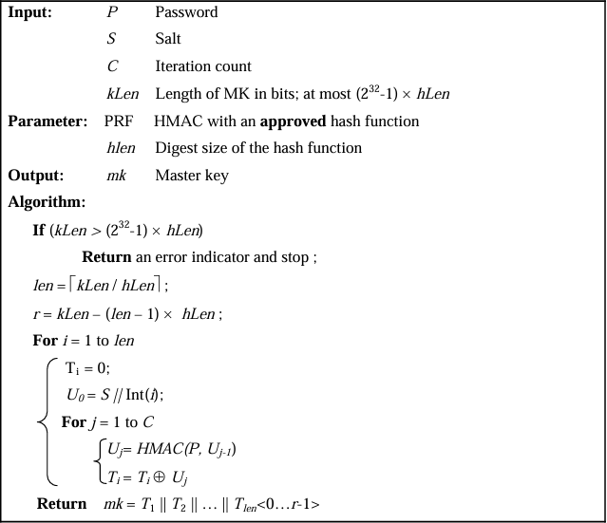
ALGORITHM
The following algorithm for the derivation of Master keys from passwords is based on algorithm, where it was specified as PBKDF2 and used HMAC with SHA-1 as a PRF. The digest size of the hash function in bits is denoted as hLen.

Slide 9
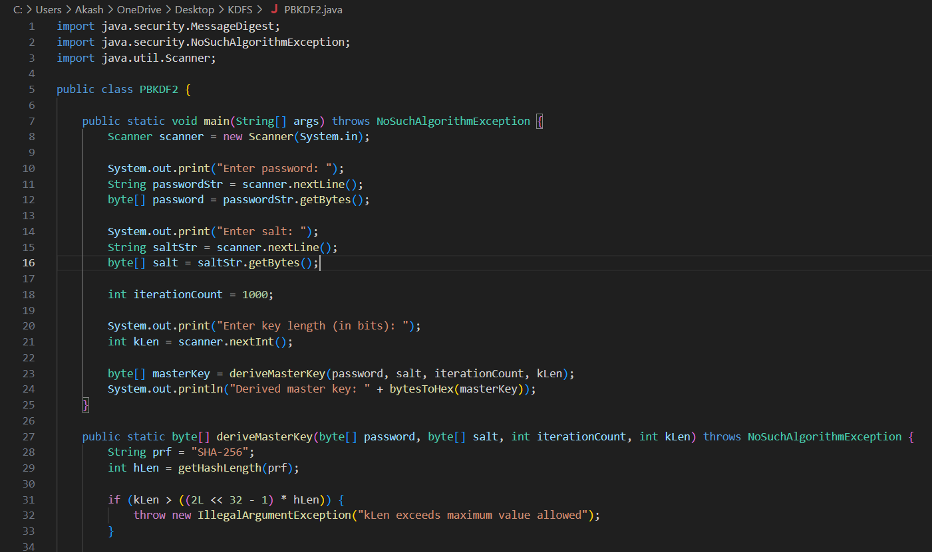
CODE:

Slide 10
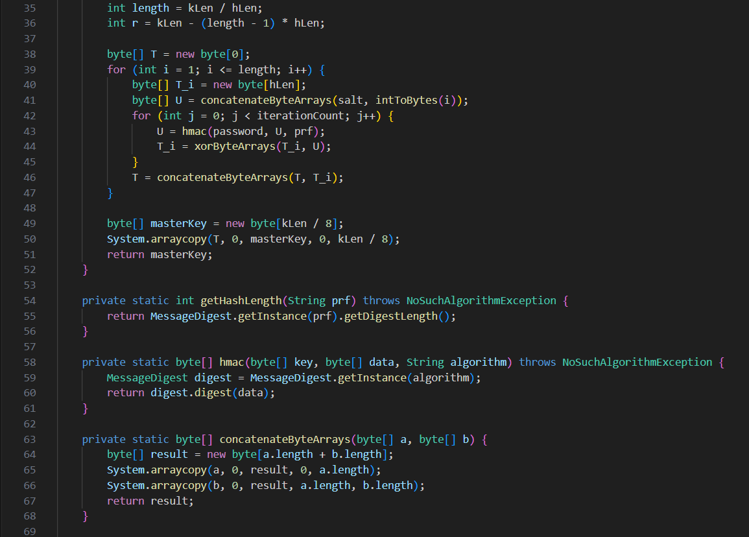

Slide 11
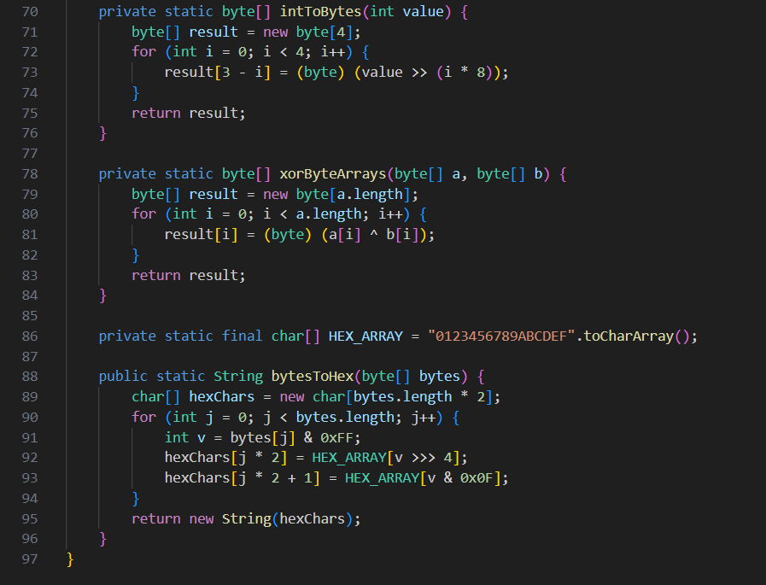

Slide 12
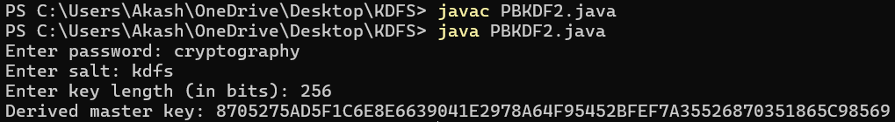
INPUT:
Provide the password .
Provide the salt – any random text.
For enter the key length provide input as 256, because we use AES-256 in the implementation.
OUTPUT:

Slide 13
ARGON 2
Working principle of Argon2
Initialization: The algorithm first creates an initial block using input values received from the user such as password, salt, and optionally provided secret data (associated data). This initial block fills a sequence of blocks using memory.
Block Filling: The algorithm then populates these memory blocks up to the set memory amount. Each block’s computation depends on previous blocks, making this stage data-dependent. Argon2d and Argon2i take distinct approaches during this block-filling process.
Final Block Creation: After filling all blocks, the algorithm selects one block as the final block.
Hash Generation: Finally, the algorithm passes this final block to a hash function to generate the final password hash.
These stages work together to ensure the security and strength of the password hashing process in Argon2. By utilizing memory-hard operations and data dependence, Argon2 aims to make password cracking attempts more computationally expensive and time-consuming.Argon2 strives to maximize data dependence, aiming to make attacks like brute force or GPU-based attacks more difficult. Because of this, Argon2 is widely recognized as a robust password hashing algorithm.

Slide 14
Hashing Passwords with Argon2 Algorithm:
Input:
password: The plaintext password to be hashed.
2. Choose Parameters:
time_cost: The number of iterations to adjust the hashing time.
memory_cost: The memory cost in kibibytes to adjust the hashing memory usage.
parallelism: The number of threads to use during hashing.
3. Hashing Password:
Create an Argon2 PasswordHasher object with the chosen parameters.
Hash the plaintext password using the hash() method of the PasswordHasher object.
The hash() method returns the hashed password.
4. Output:
hashed_password: The resulting hashed password.
Verifying Passwords with Argon2 Algorithm:
1. Input:
hashed_password: The previously hashed password.
password: The plaintext password to be verified against the hashed password.
2. Verify Password:
Try to verify the password using the Argon2 PasswordHasher object's verify() method.
If the verification succeeds (i.e., the passwords match), return True.
If a VerifyMismatchError exception is raised during verification, catch it and return False.
3. Output:
True if the password matches the hashed password, False otherwise.

Slide 15
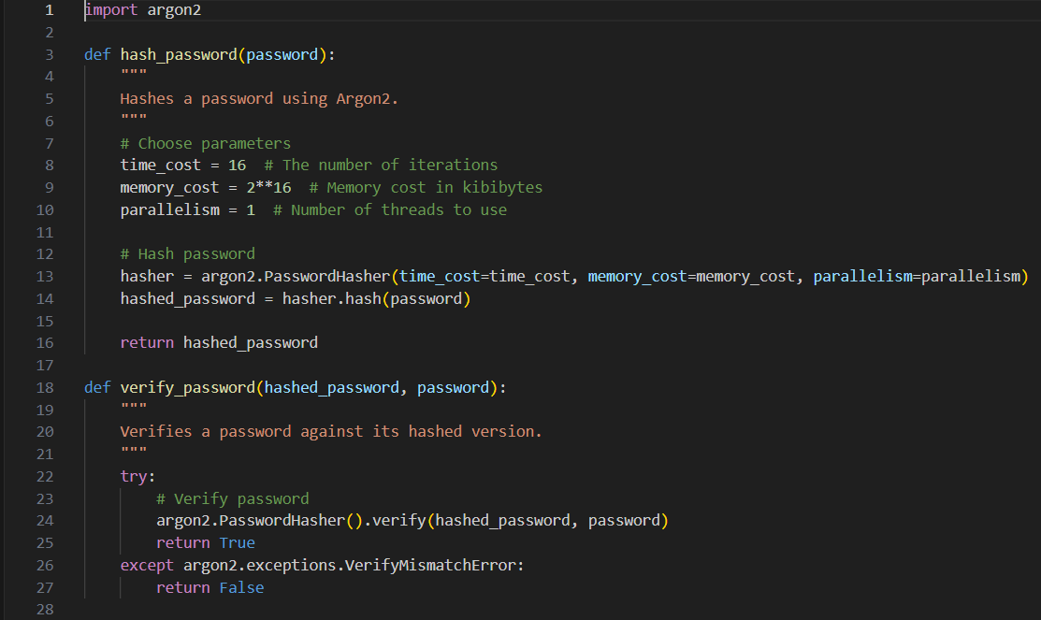
CODE:

Slide 16
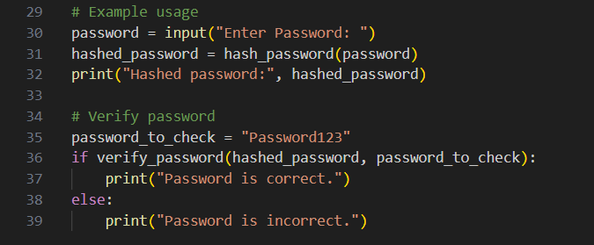
INPUT:
Just provide the Password as input.
For any password other than Password123, it gives Password is incorrect as output, because in implementation
I have given reference password as Password123.
OUTPUT:

Slide 17
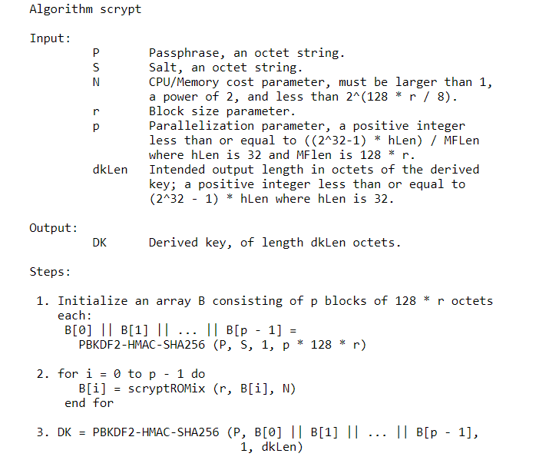
SCRYPT
It is memory-hard function, meaning it requires significant memory resources to compute, making it resistant to parallelization attacks.
Scrypt is designed to be computationally intensive and memory-intensive, providing a strong defense against hardware-based attacks.
Scrypt's adjustable parameters include memory cost, parallelization factor, and iteration count, allowing users to customize security and performance.

Slide 18
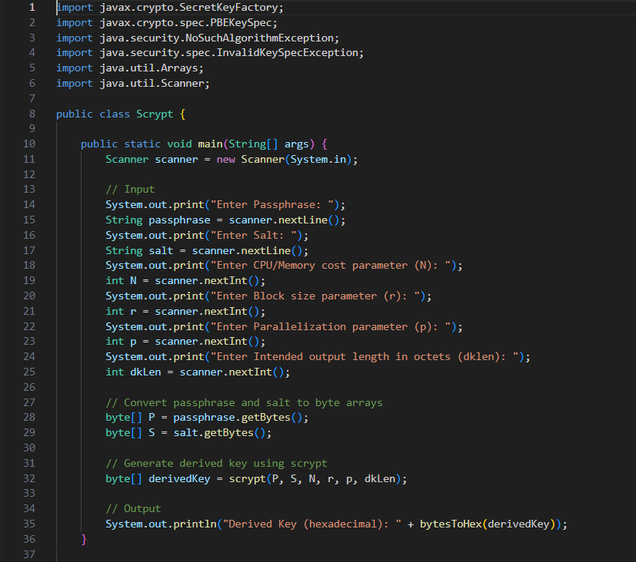
CODE:

Slide 19
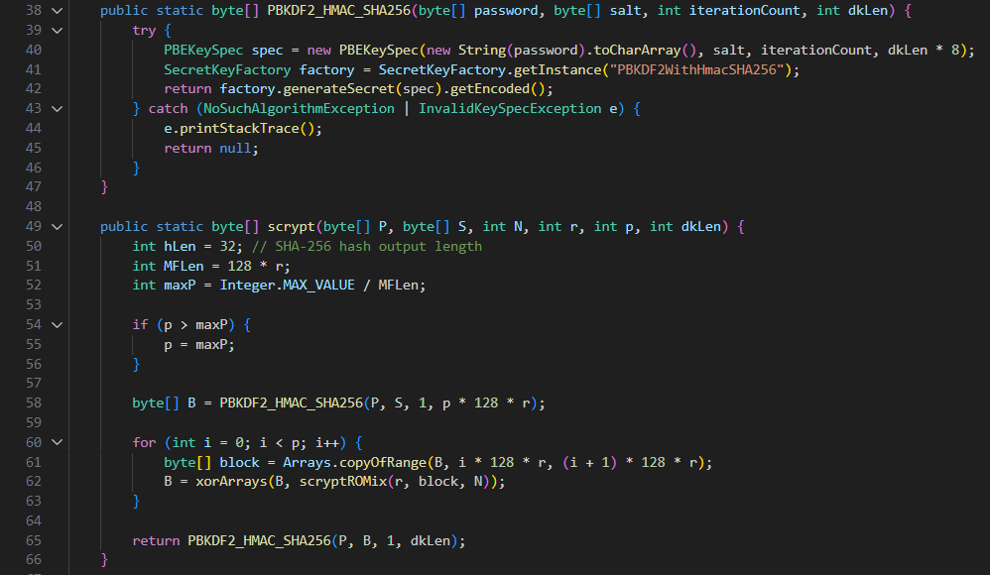

Slide 20
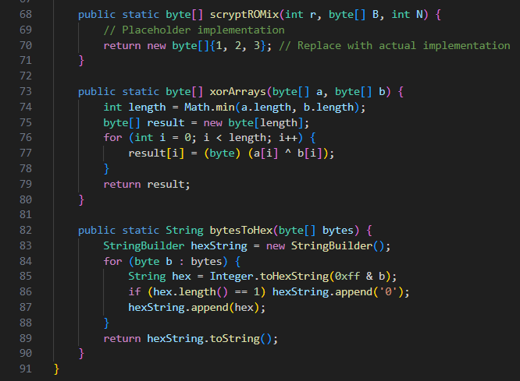

Slide 21
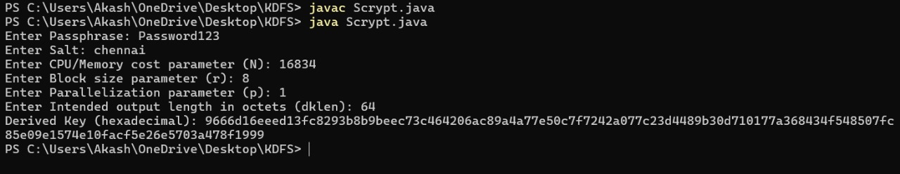
INPUT:
Enter the password for key derivation.
Enter the salt.
Enter CPU cost parameter. It generally takes large numbers in powers of 2.
Enter the number of blocks that the password needs to be broken for key derivation process.
Parallelization parameter determines how much memory and CPU resources are used during the key derivation process. It controls the degree of parallelism.
dklen is derived key length. It can be 64 or 128.
OUTPUT:

Slide 22
BCRYPT
Blowfish is a 64-bit block cipher, structured as a 16-round Feistel network [14]. It uses 18 32-bit subkeys, p1, p2, …, p18 which it derives from the encryption key. The subkeys are known collectively as the P-Array.
Blowfish encrypts by splitting a 64-bit input block into two 32-bit halves, L0 and R0. The most-significant half, L0, is XORed with subkey P0, and used as input for a function F. The result of that function is XORed with the least-significant half, R0. The two halves are then swapped, and the whole process repeated another 15 times for a total of 16 iterations.
After 16 rounds, the two halves are swapped again (undoing the effect of the 16th swap), and each half is XORed with another 32-bit subkey

Slide 23
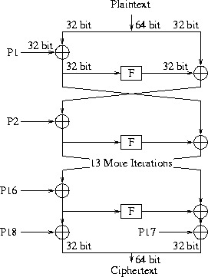

Slide 24
ALGORITHM
Function: bcrypt(password, salt, costFactor)
Input:
password: User's password as a string
salt: Random salt value as a string
costFactor: Cost factor (work factor) as an integer
Output:
hashedPassword: Hashed password as a string
Steps:
1. Generate a salt value if not provided. The salt should be a random string of sufficient length.
2. Generate a cryptographically secure random salt if not provided by the caller.
3. Concatenate the password and the salt.
4. Hash the concatenated string using the Blowfish cipher in multiple iterations, specified by the costFactor parameter.
5. Return the hashed password as a string.

Slide 25
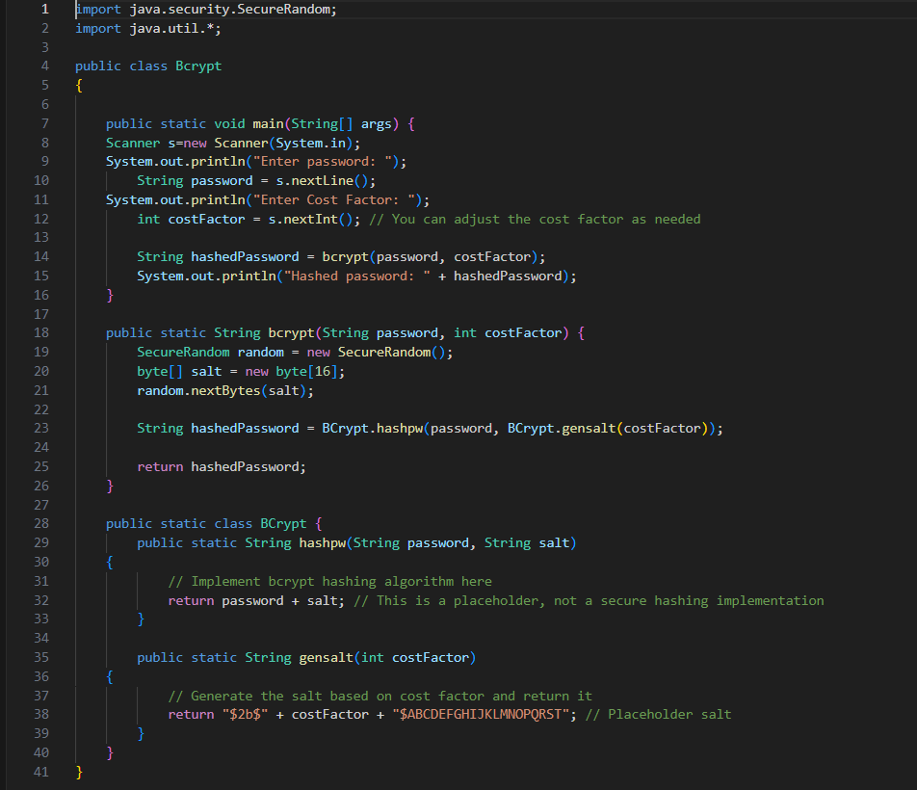
CODE:

Slide 26
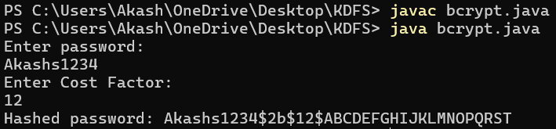
INPUT:
Enter the password.
Enter the cost factor- the cost factor is to make password hashing slow, thereby increasing the time and computational resources required for attackers to perform brute-force attacks. It takes values like 10,12 and 14.
OUTPUT:

Slide 27
CONCLUSION
In conclusion, the secure storage of passwords is a critical aspect of modern cybersecurity, necessitating the use of robust key derivation functions (KDFs) to safeguard sensitive user credentials. Key derivation functions such as PBKDF2, Argon2, scrypt, and bcrypt offer various levels of security and performance, each with its unique strengths and considerations. Among these four KDFs, scrypt is found to be best in deriving strong and secure key.

Slide 28
REFERENCES
http://www.refworks.com/express/expressimport.asp?vendor=IEEE&filter=RefWorks%20Tagged%20Format&database=&url=https%3A%2F%2Fieeexplore-ieee-org.egateway.chennai.vit.ac.in%2Fxpl%2FrefWorkGen%3Farnumber%3D8981844%26dlSelect%3Dcite%26fileFormat%3DRefWork&encoding=65001
https://en.wikipedia.org/wiki/PBKDF2
http://nvlpubs.nist.gov/nistpubs/Legacy/SP/nistspecialpublication800-132.pdf
https://www.bsdcan.org/2009/schedule/attachments/87_scrypt.pdf
https://www.rfc-editor.org/rfc/rfc7914?trk=public_post_comment-text#page-3
https://www.usenix.org/legacy/events/usenix99/provos/provos_html/node5.html
https://www.mdpi.com/2076-3417/13/16/9295

